Slide 1
Final Project Figures

Slide 2
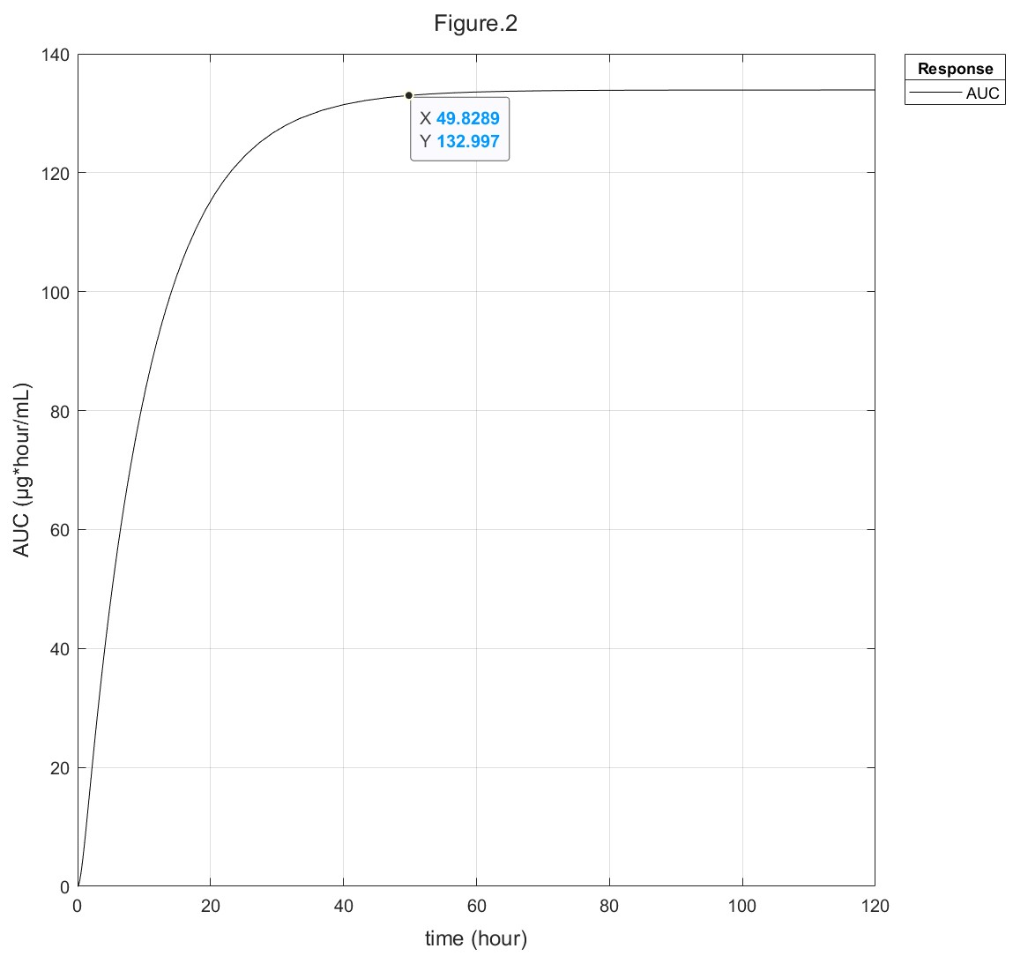
Figure 2: 10mg/kg single oral dose plasma AUC over time

Slide 3
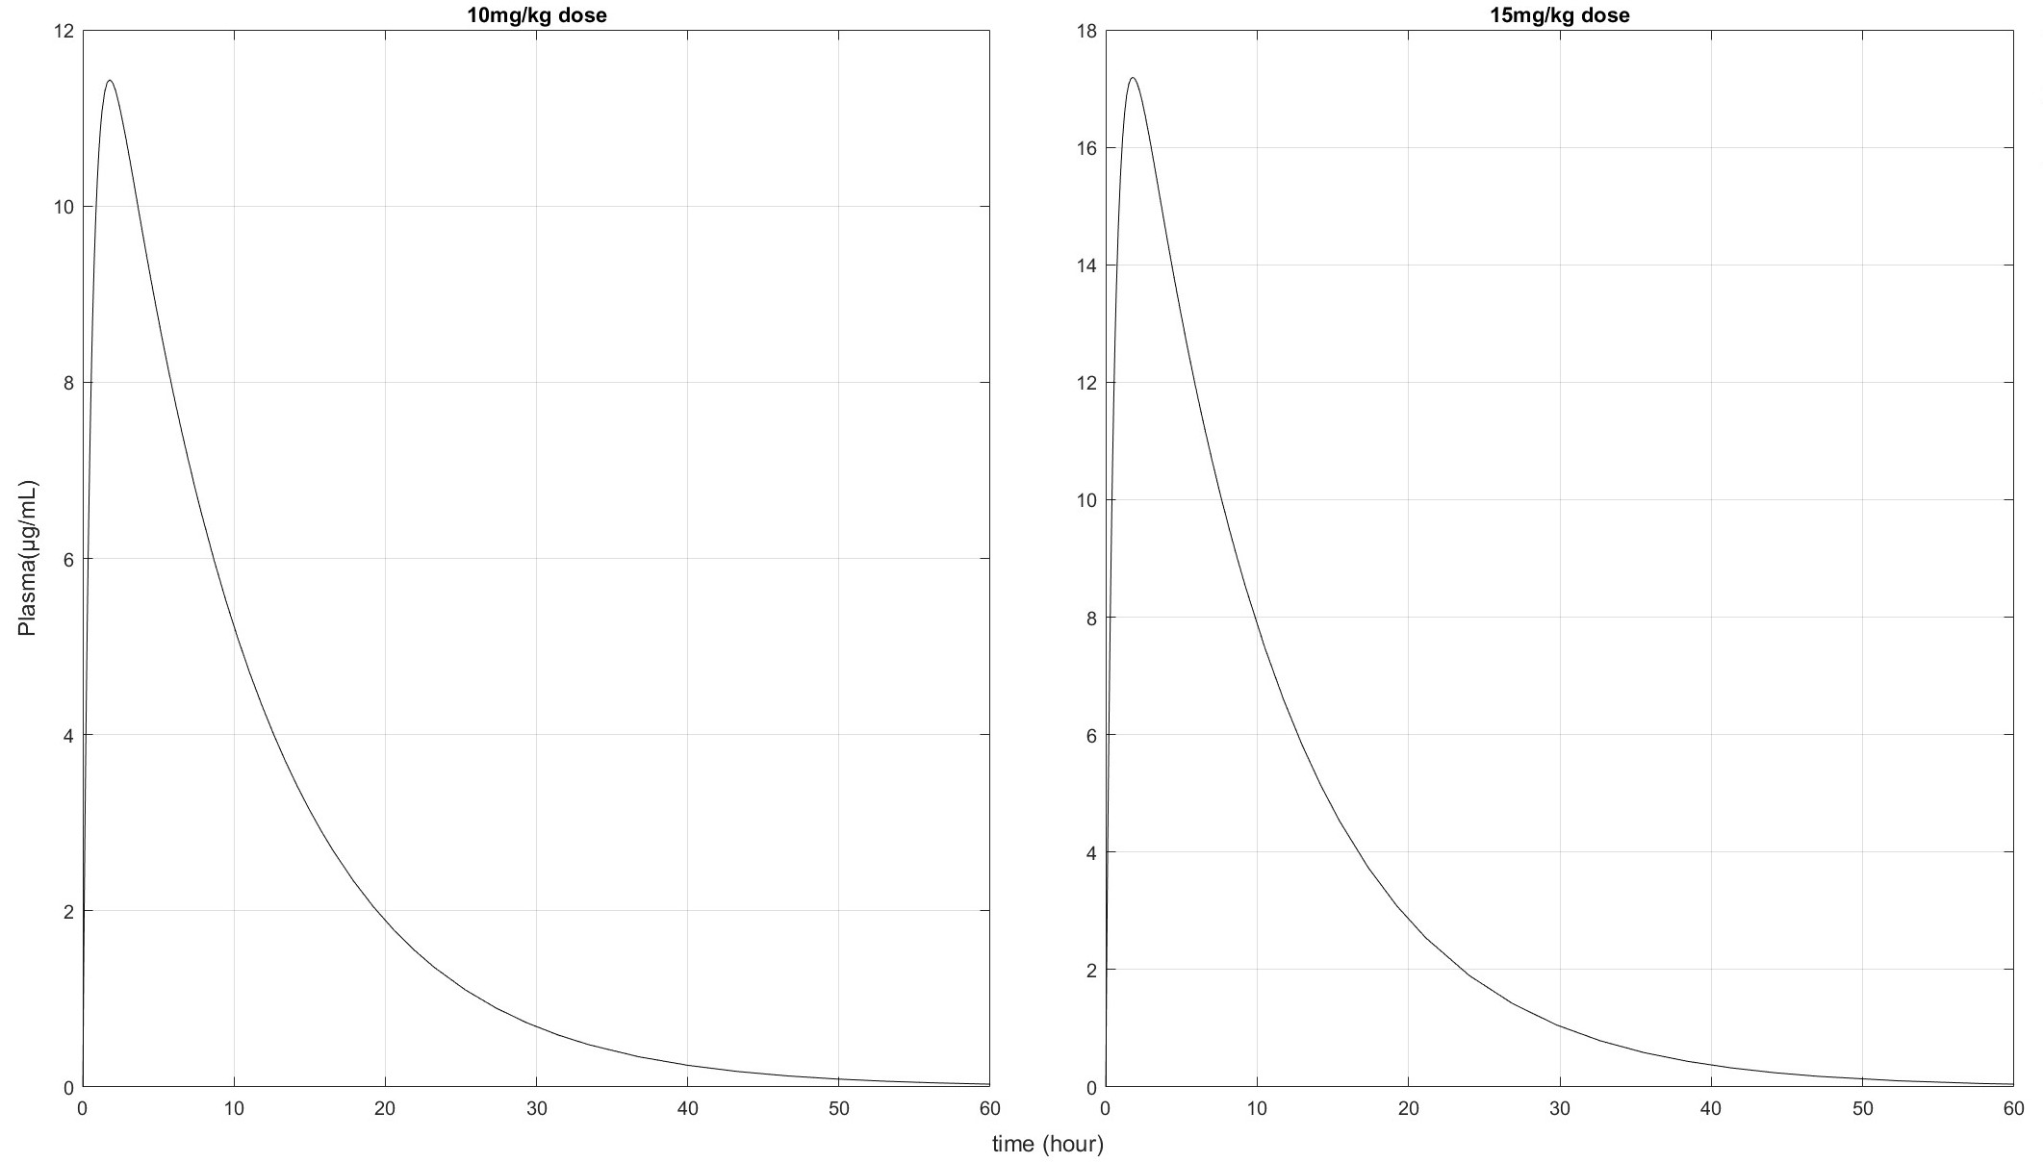
Figure 3: 10mg/mL and 15mg/kg oral bolus dose Rifampin concentrations over time in mouse plasma

Slide 4
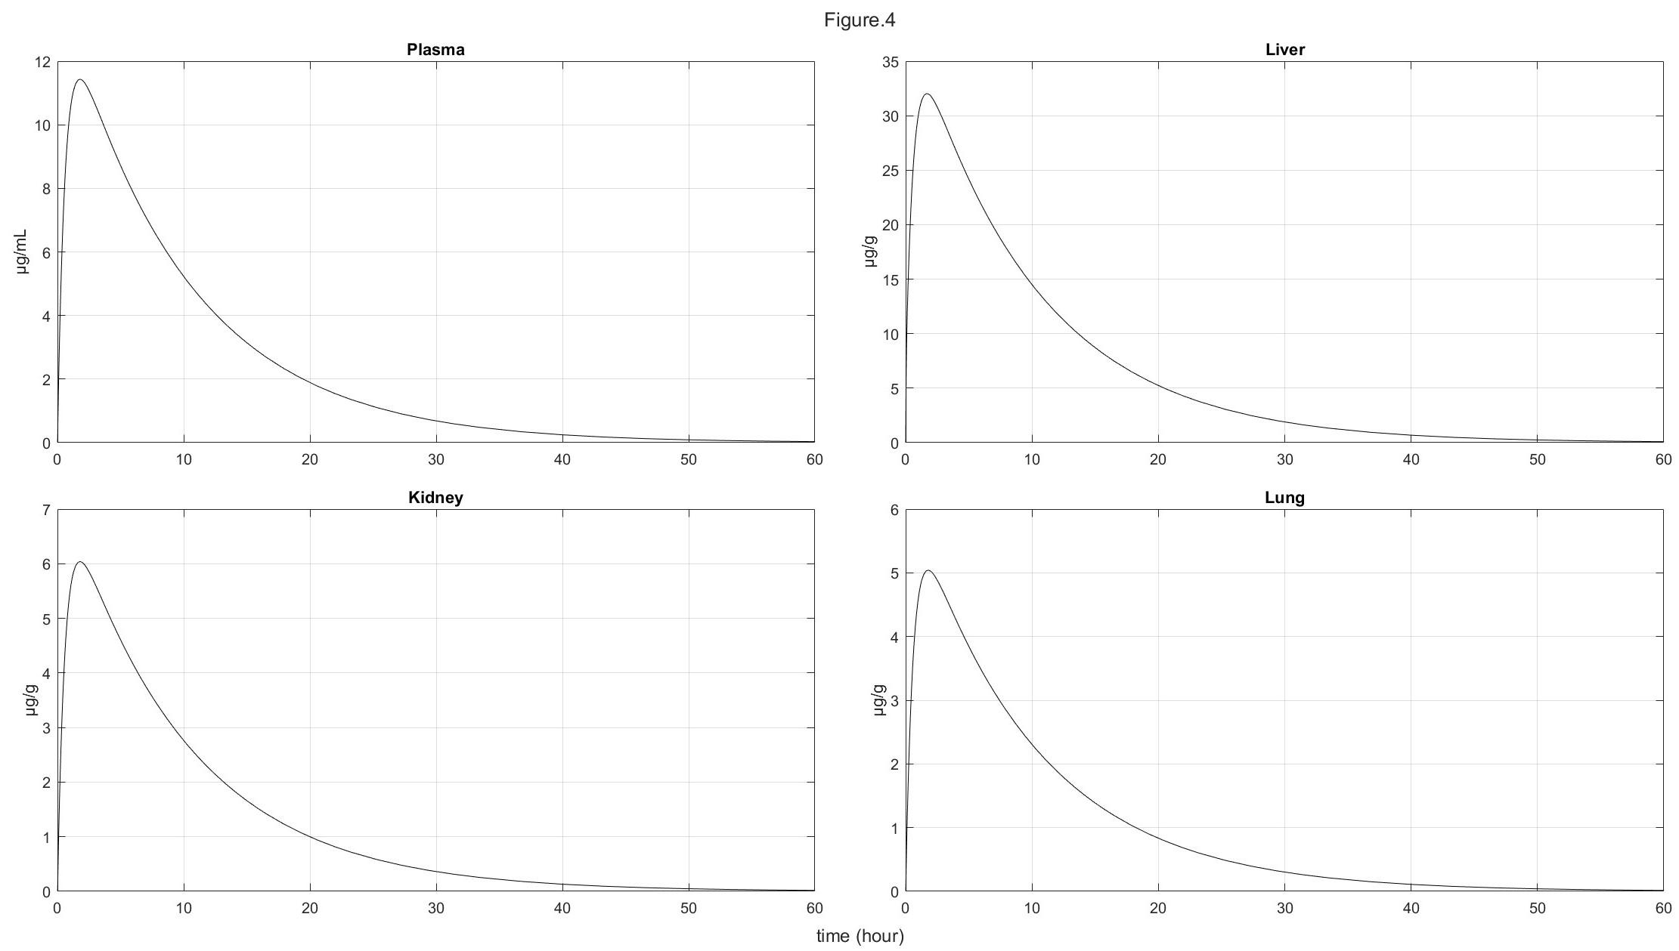
Figure 4: 10mg/mL oral bolus dose Rifampin concentrations over time in mouse plasma, lung, liver, and kidney

Slide 5
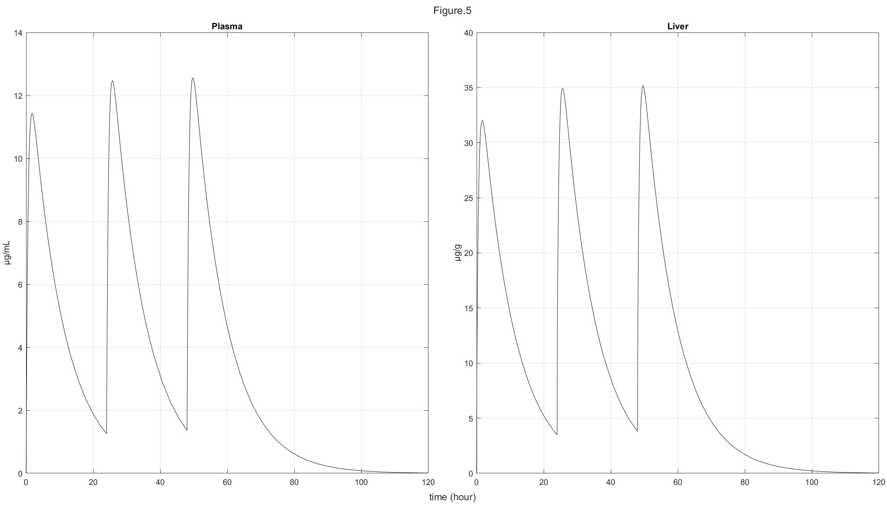
Figure 5: 10mg/mL 24 thrice repeated oral bolus dose Rifampin concentrations over time in mouse plasma and liver

Slide 6
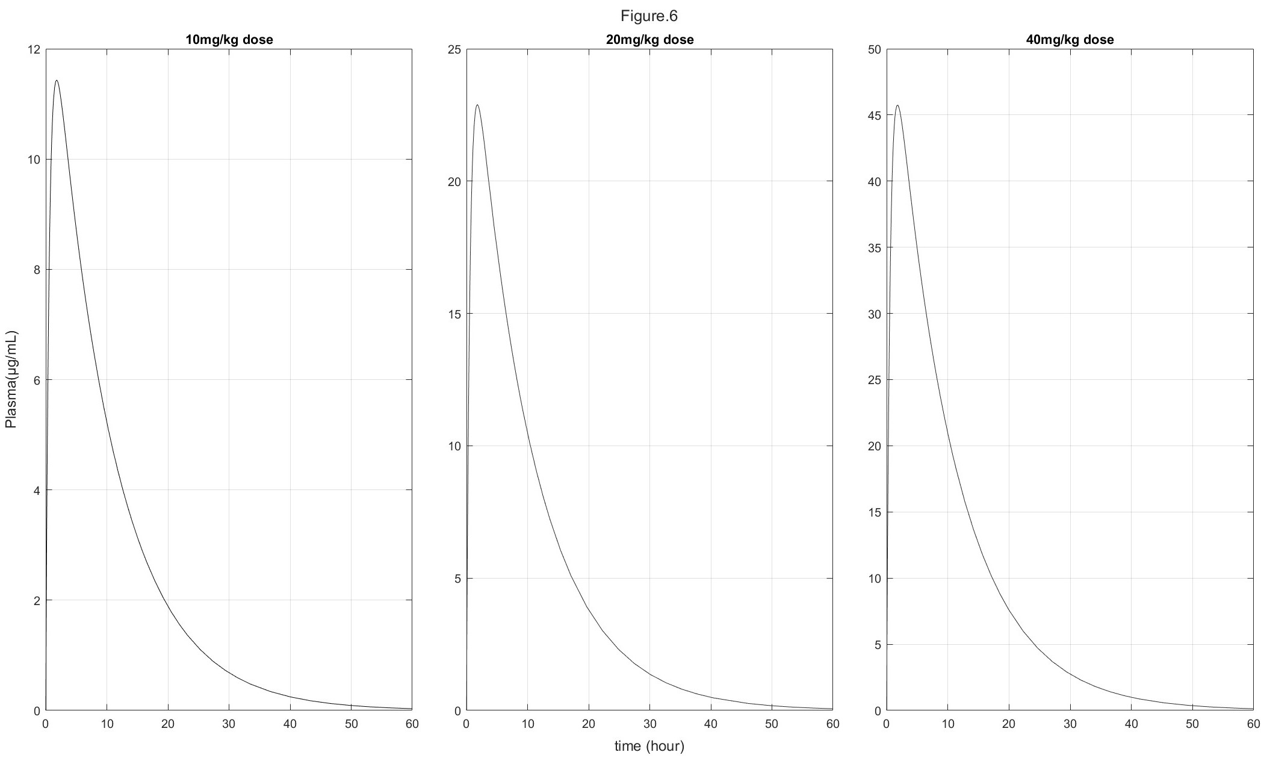
Figure 6: 10mg/mL, 20mg/kg, and 40mg/kg oral bolus dose Rifampin concentrations over time in mouse plasma

Slide 7
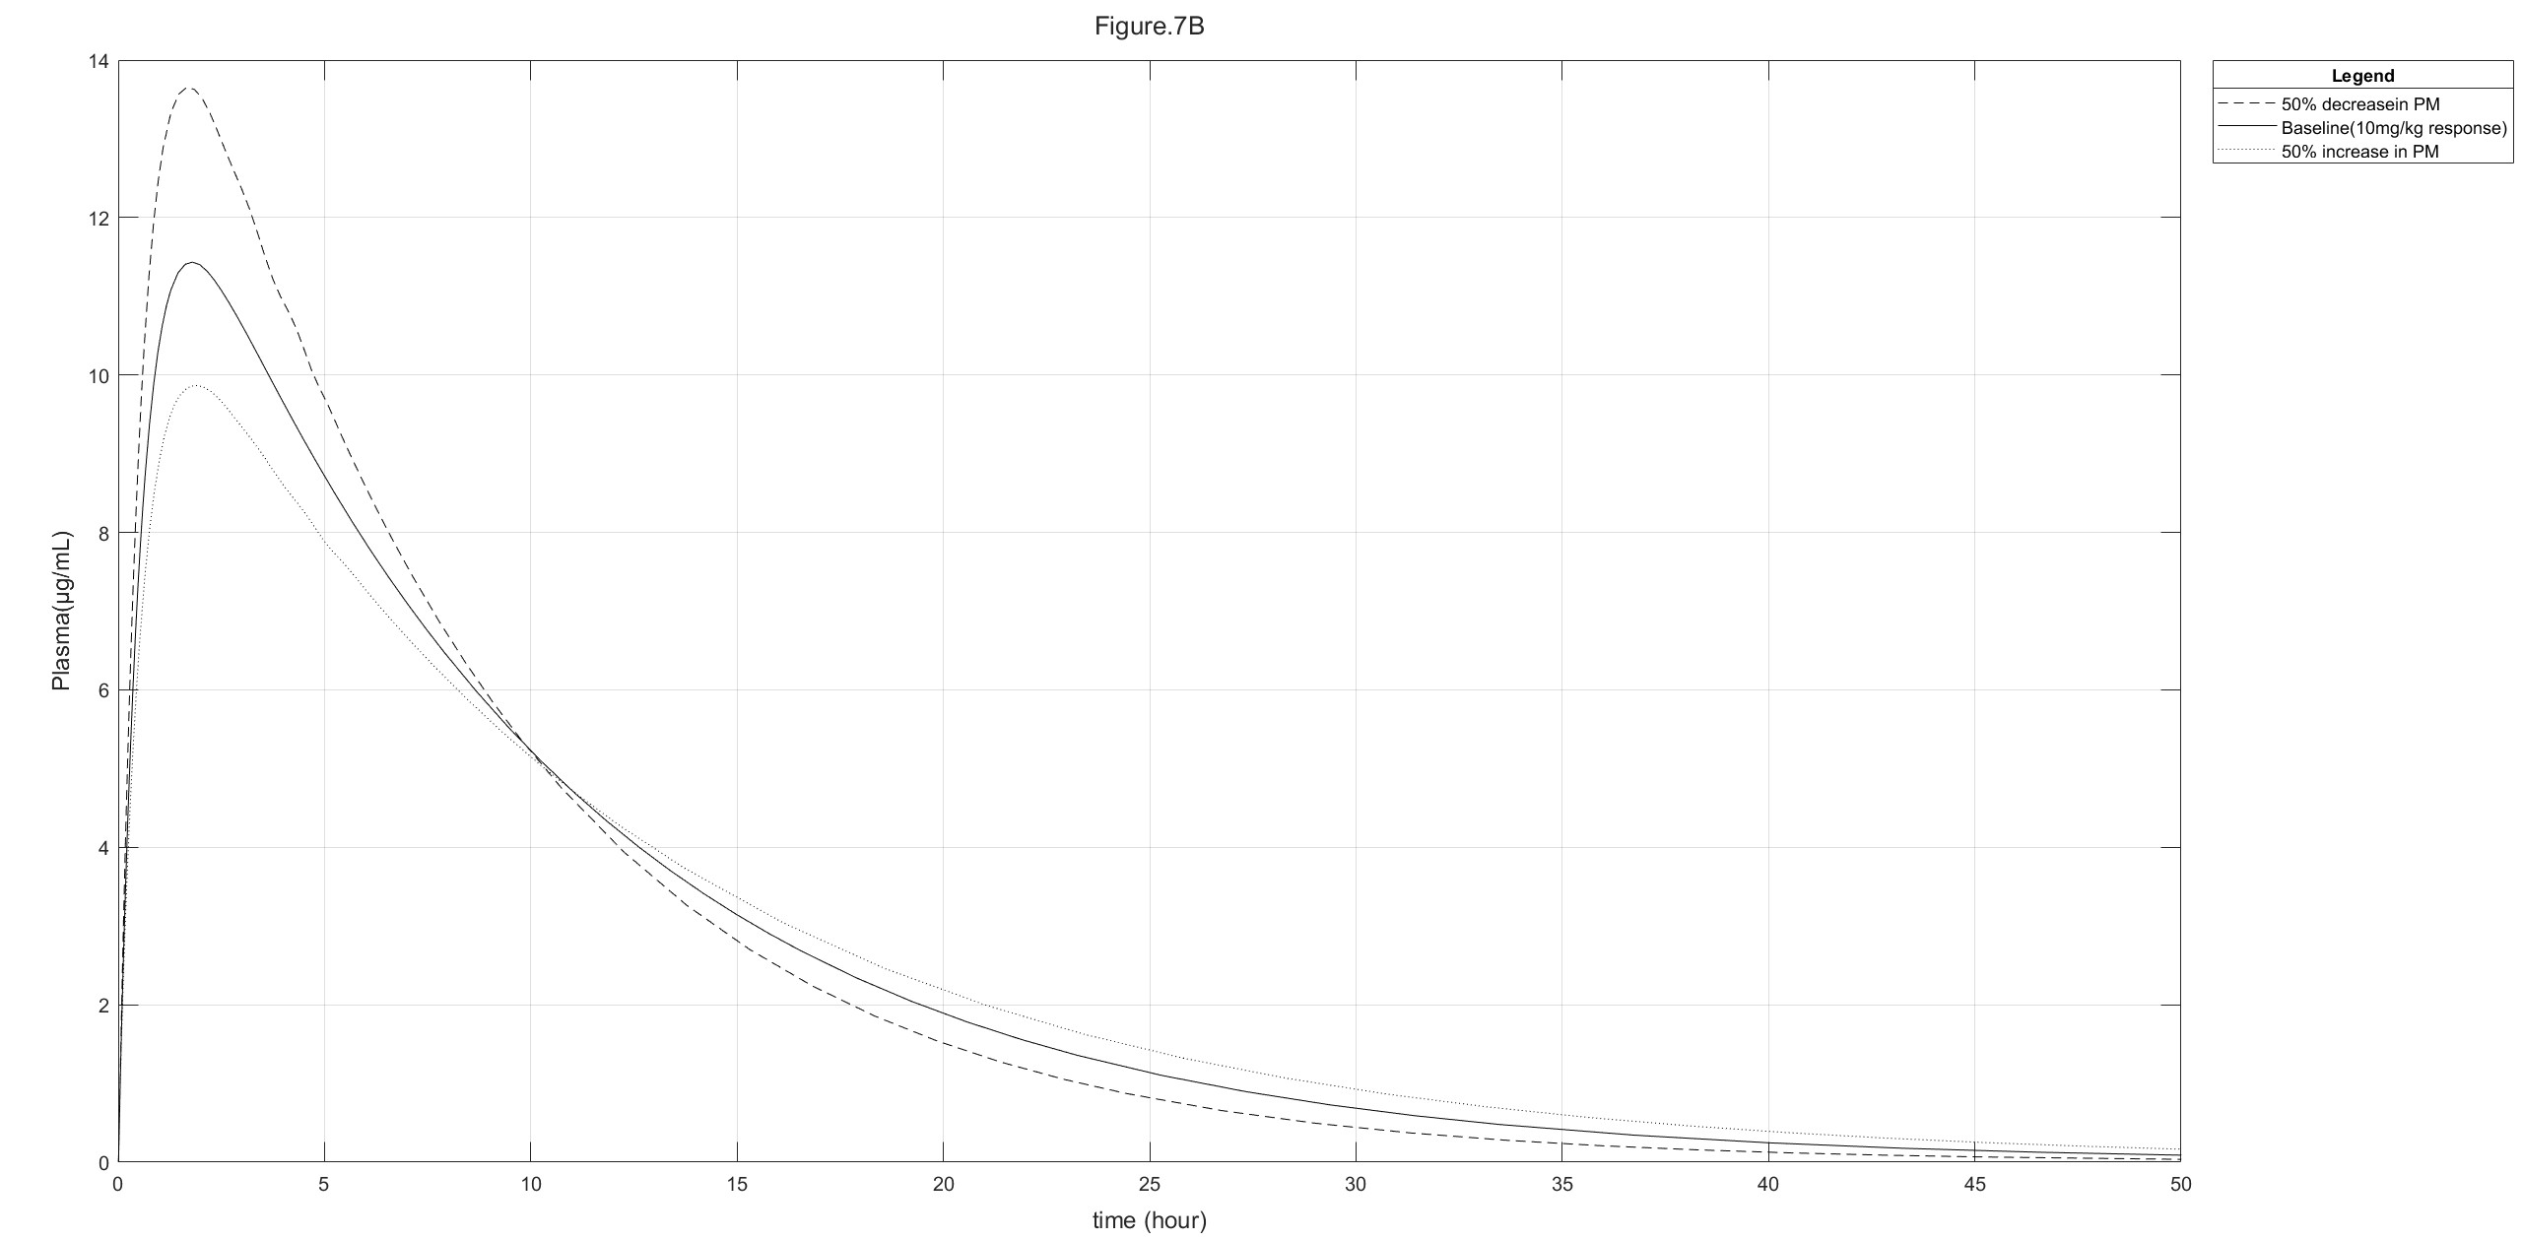
Figure 7: 10mg/mL baseline plasma Rifampin concentration over time with a 50% increase and decrease in PM

Slide 8
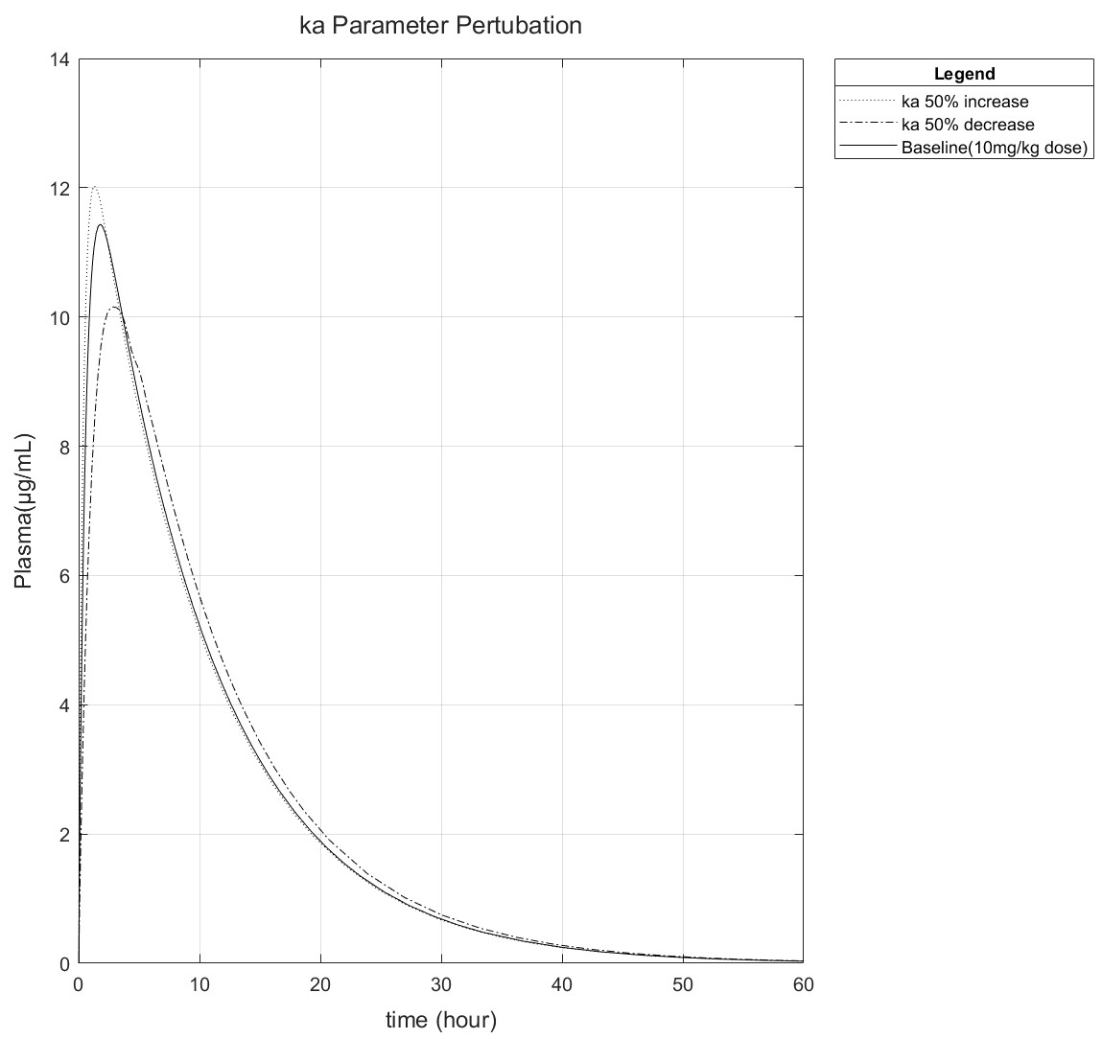
Figure 8: 10mg/mL baseline plasma Rifampin concentration over time with a 50% increase and decrease in absorption rate(ka)

Slide 9
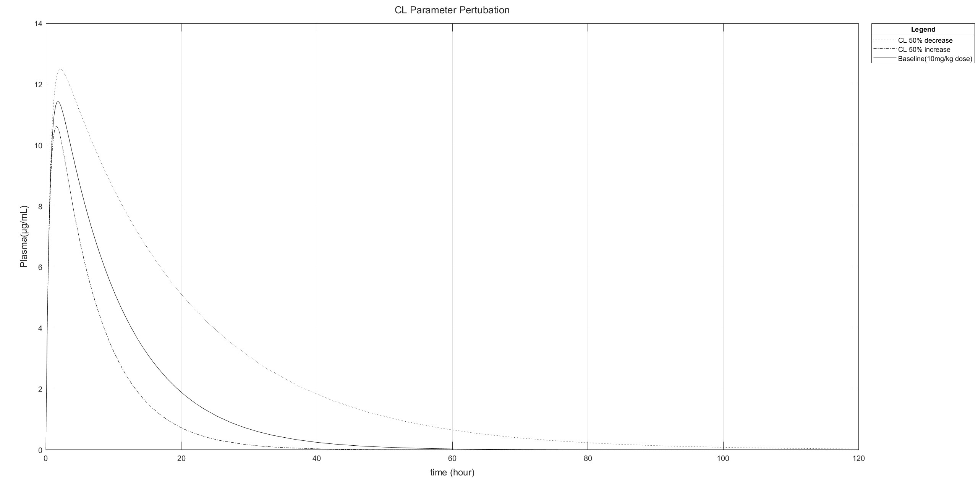
Figure 9: 10mg/mL baseline plasma Rifampin concentration with a 50% increase and decrease in clearance rate(CL)

Slide 10
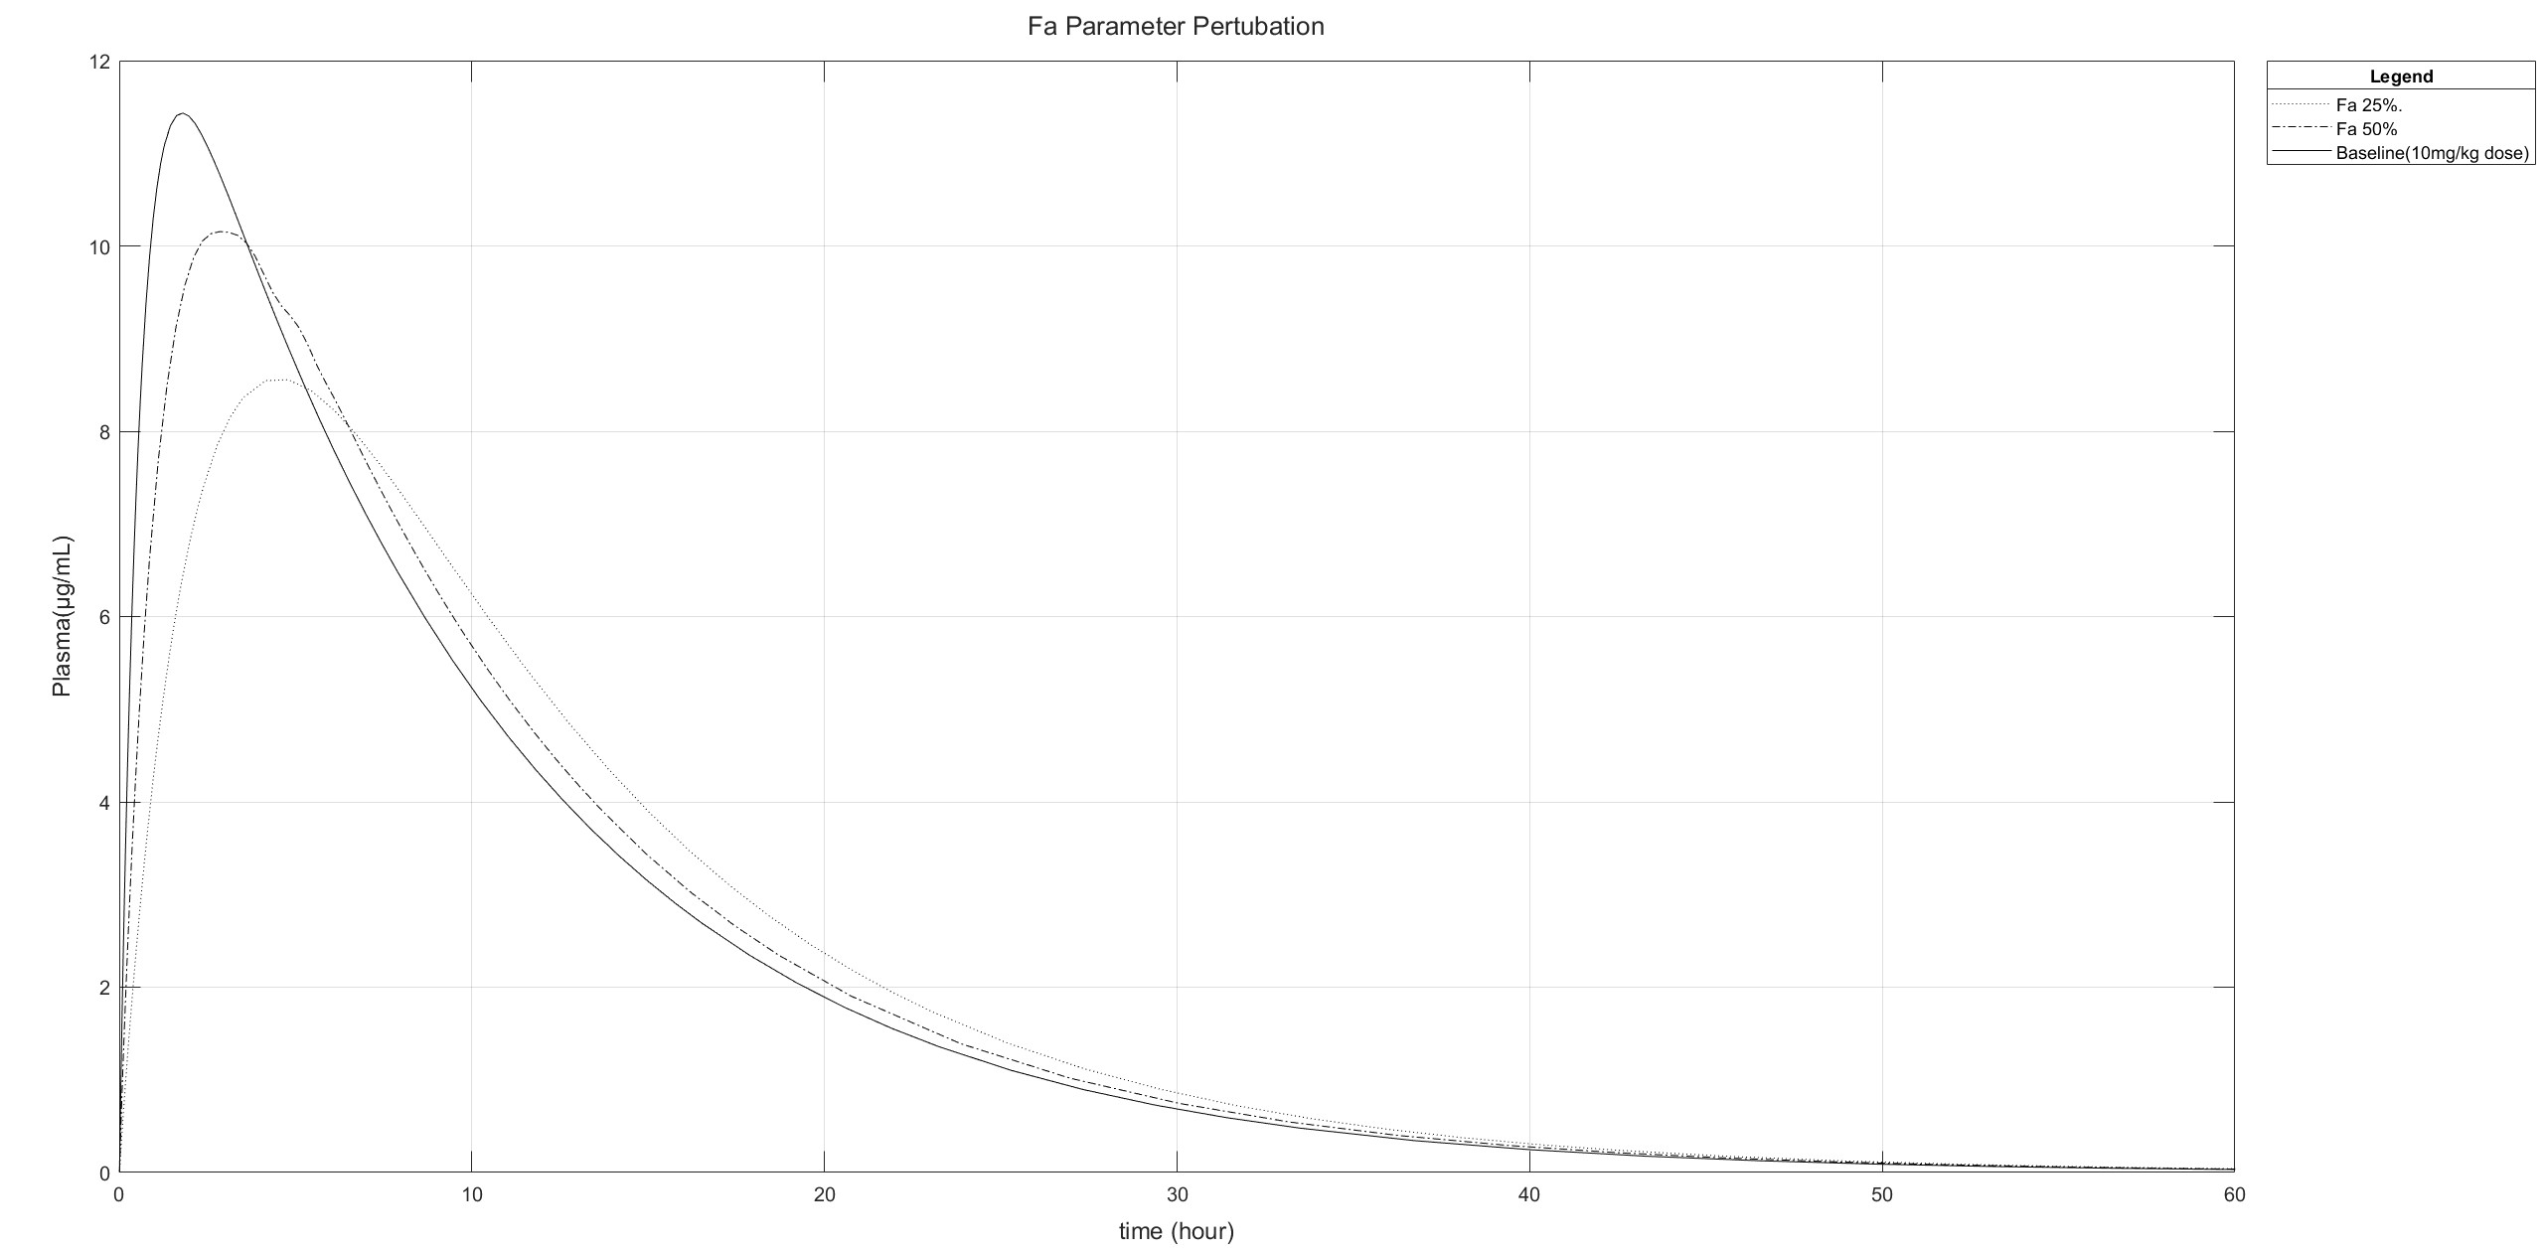
Figure 10: 10mg/mL baseline mouse plasma Rifampin concentration with a 50% increase and decrease in Bioavailability(Fa)

Slide 11
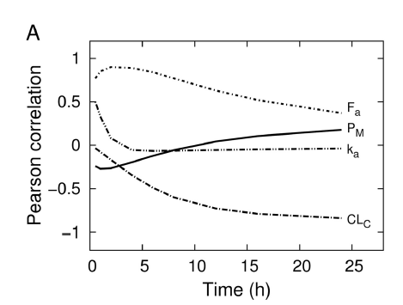
Figure 11: Pearson correlation coefficients between sensitive parameters and 10mg/kg dose of rifampin plasma concentration as a function of time

Slide 12
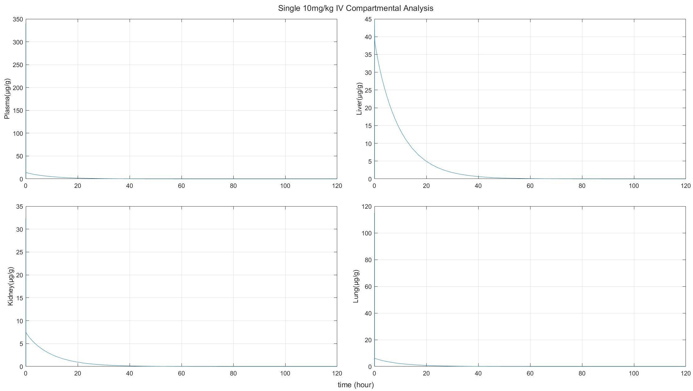
Figure 12: 10mg/mL IV bolus dose Rifampin concentrations in mouse plasma, lung, liver, and kidney

Slide 13
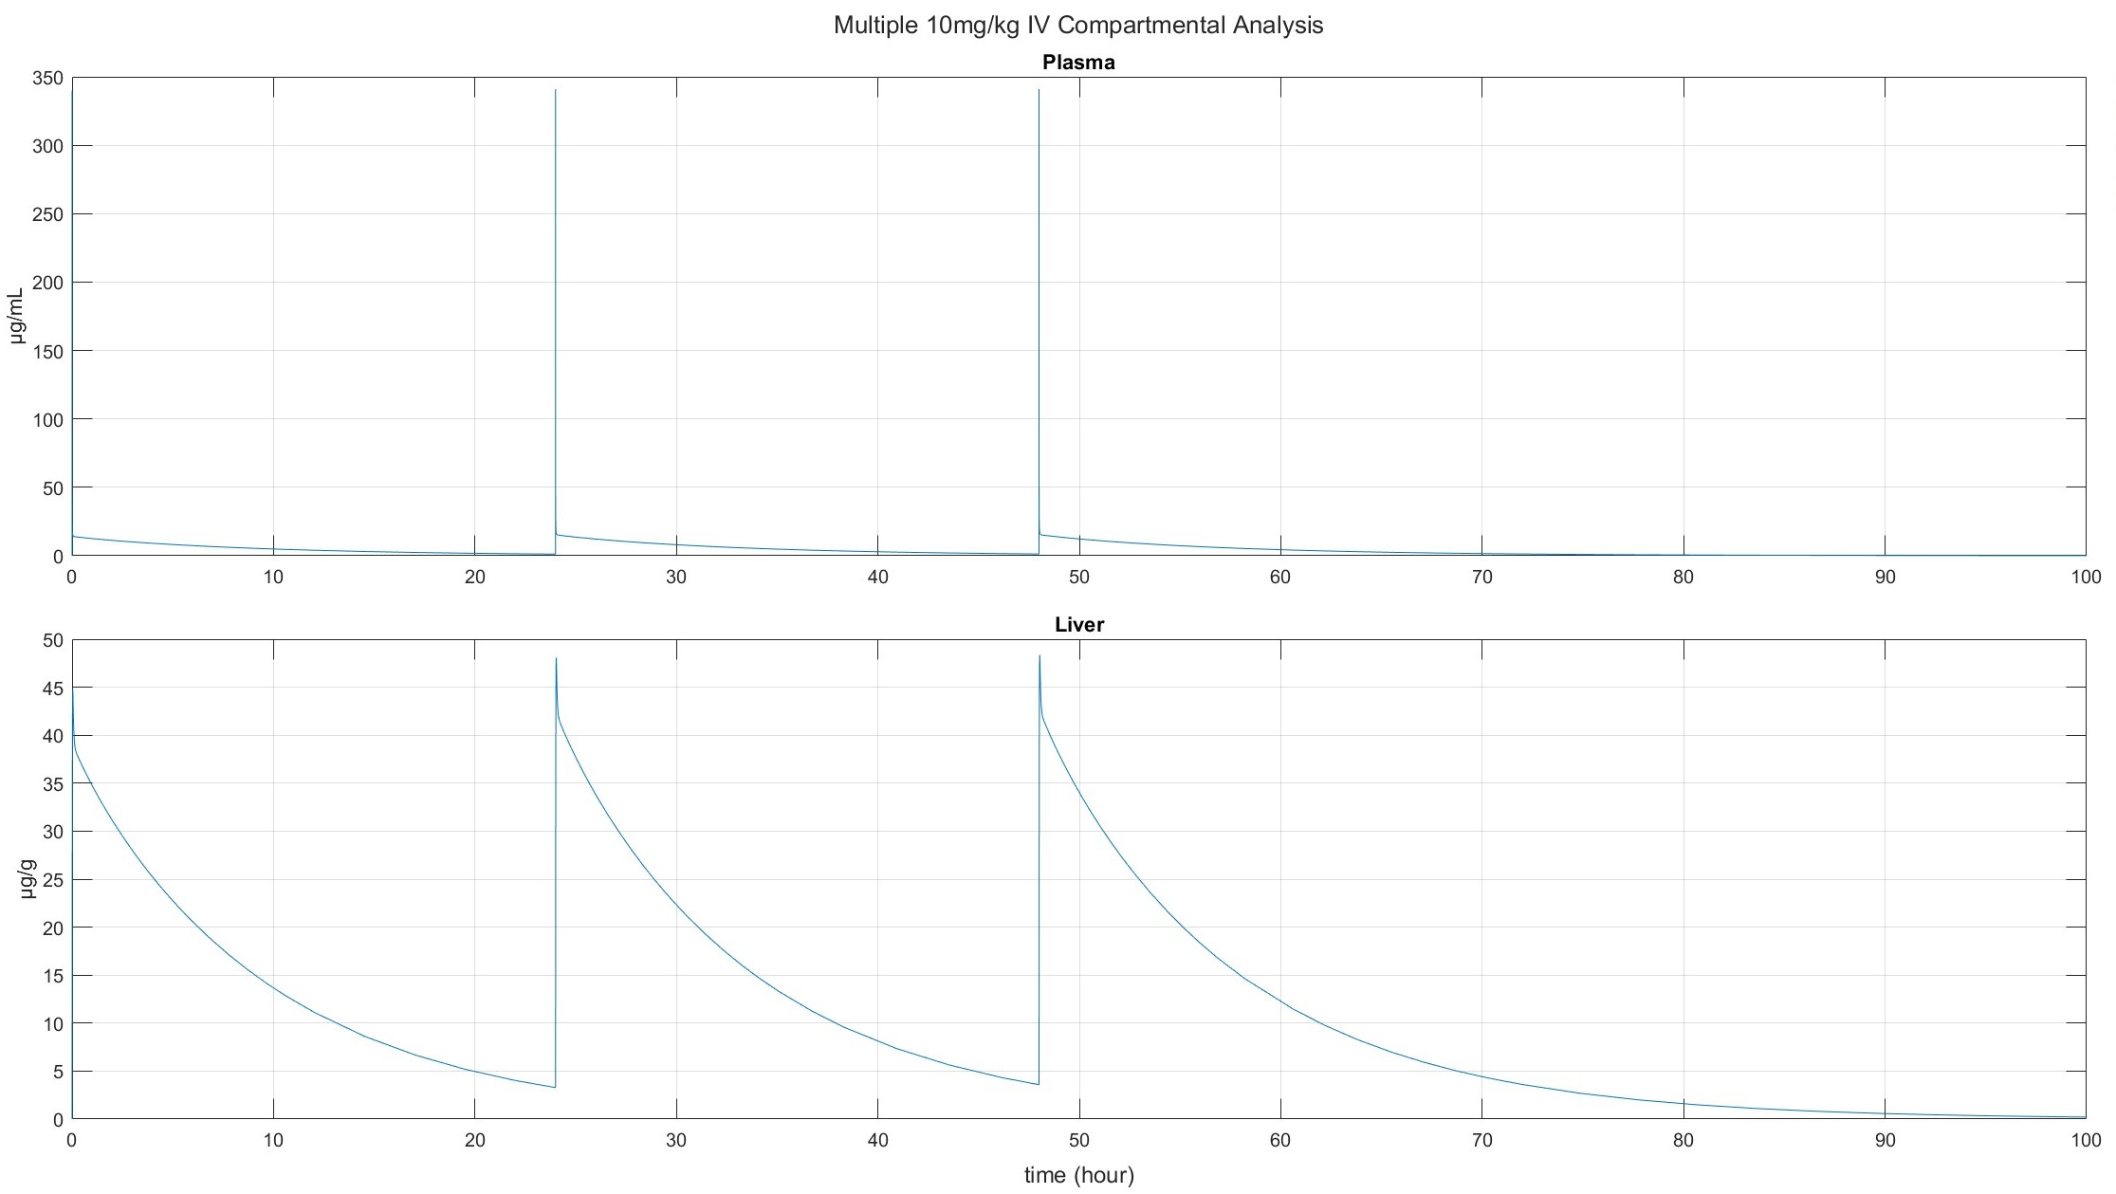
Figure 13: 10mg/mL repeated IV bolus dose Rifampin concentrations in mouse plasma and liver

